Slide 1


GLOBAL GROUP OF INSTITUTES
Foodies Point Restaurant Website
Presented By:
Yogita Vohra(191909511783)
Akshat Bhatia()
Aniket Thakur()
Submitted As:
Major Project
Of
Diploma CSE
6th semester

Slide 2

CONTENTS
Abstract
Objective
Features
Technologies Used
Flow Chart
Snapshots
Conclusion
Future Scope

Slide 3

ABSTRACT
“Foodies Point Restaurant Website is actually a website project for a restaurant. The coding for the project is fully done in VS Code. The languages used for the coding are HTML,CSS and JS. AOS(Animate On Scroll) library has been used in the coding to make the website more attractive. The user can explore the menu, offers and other related information of the restaurant. The user can also book a table in the restaurant through the website. The users are free to send their reviews & messages about the restaurant through our website”

Slide 4

OBJECTIVE
Creating a user interactive website.
Giving information about the restaurant for customer satisfaction.
Allowing customers to give feedback.
Customers can book a table online.

Slide 5

FEATURES
Easy to use
Mobile Optimized
Well Designed & Functional
User Friendly
Secure

Slide 6



TECHNOLOGIES USED
HTML:
Stands for Hyper Text Markup Language, is the most widely used language on Web to develop web pages.
CSS:
Cascading Style Sheets is a style sheet language used for describing the presentation of a document written in a markup language such as HTML.

Slide 7


TECHNOLOGIES USED
JavaScript:
Often abbreviated as JS, used by programmers across the world to create dynamic and interactive web content like applications and browsers.
VS Code:
Visual Studio Code, is a source-code editor made by Microsoft. It include support for debugging, syntax highlighting, intelligent code completion, snippets, code refactoring, and embedded Git

Slide 8


TECHNOLOGIES USED
GitHub:
GitHub is a code hosting platform for version control and collaboration. It lets you and others work together on projects from anywhere.
Netlify:
A web developer platform that offers hosting and serverless backend services for web applications and static websites

Slide 9

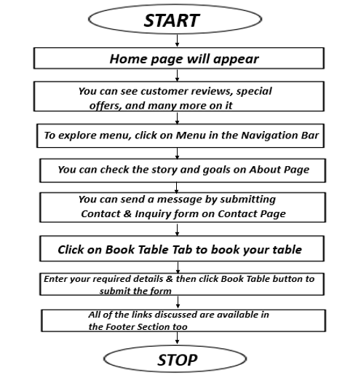
FLOWCHART
Flowchart for the user:

Slide 10
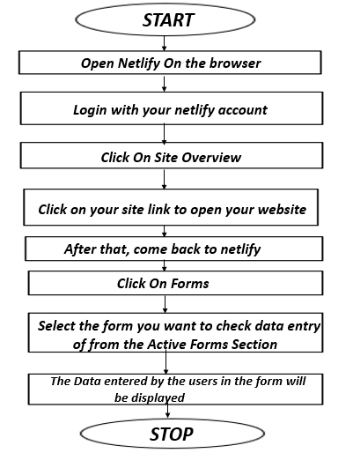
FLOWCHART
Flowchart for the admin:

Slide 11

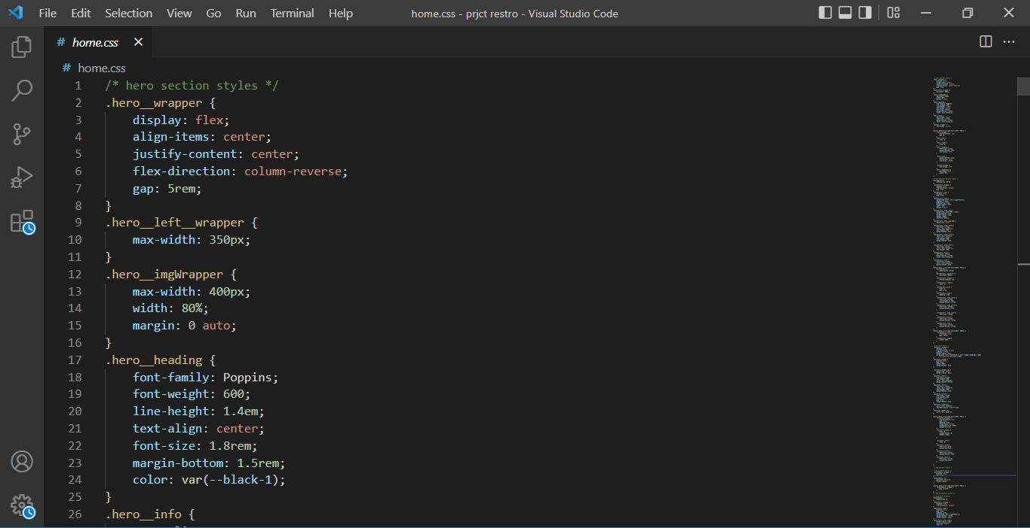
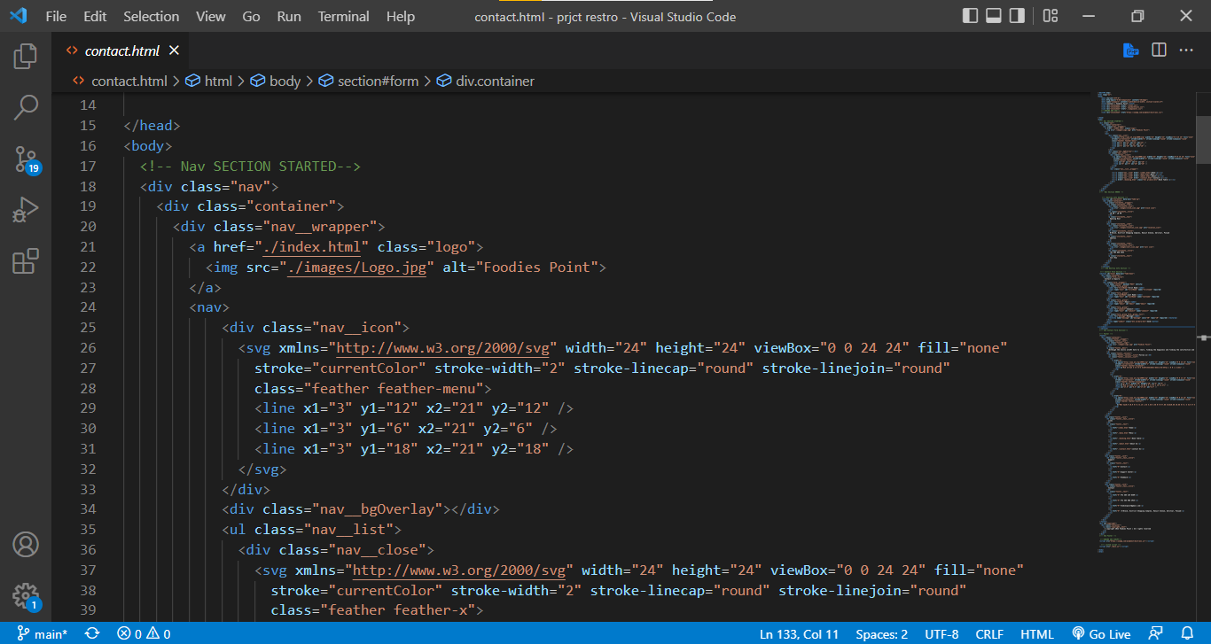
SNAPSHOTS
Snapshots from VS Code:

Slide 12
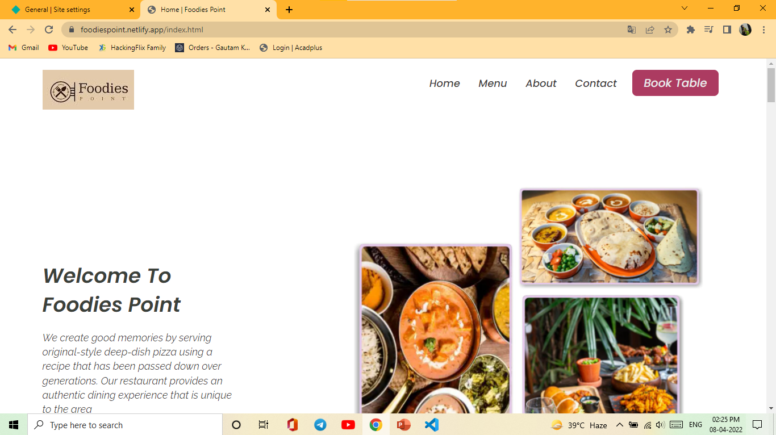
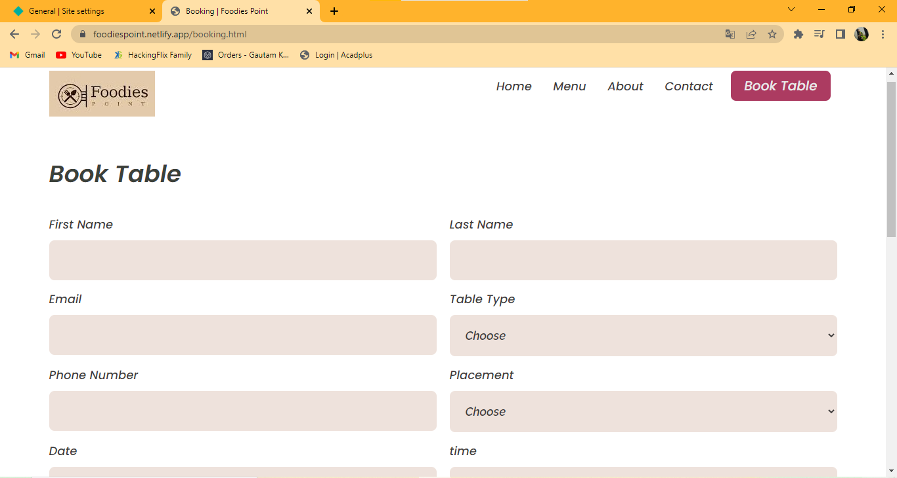
SNAPSHOTS
Snapshots from the Website
(big screen view):

Slide 13
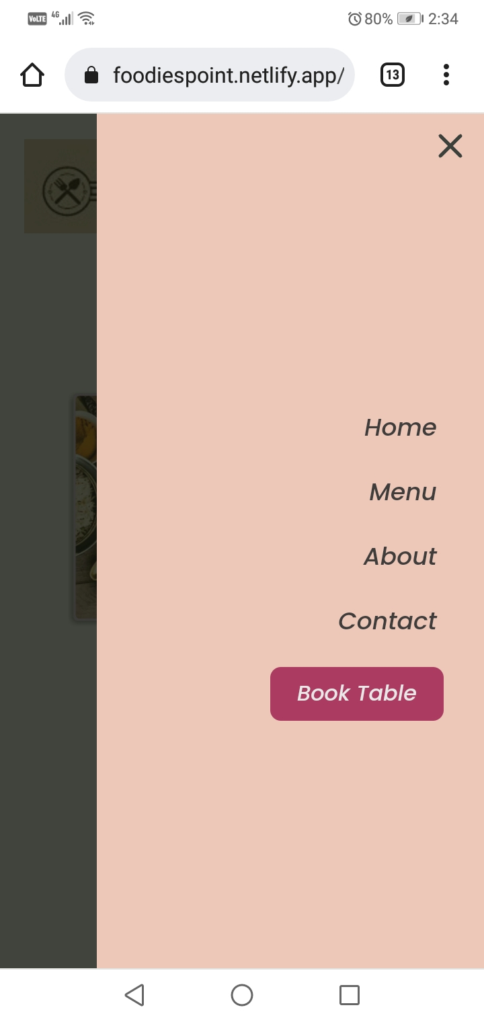
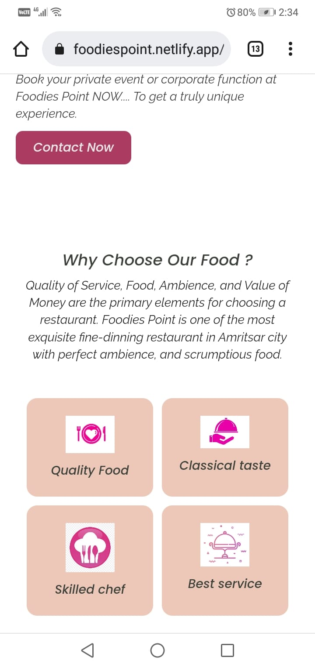
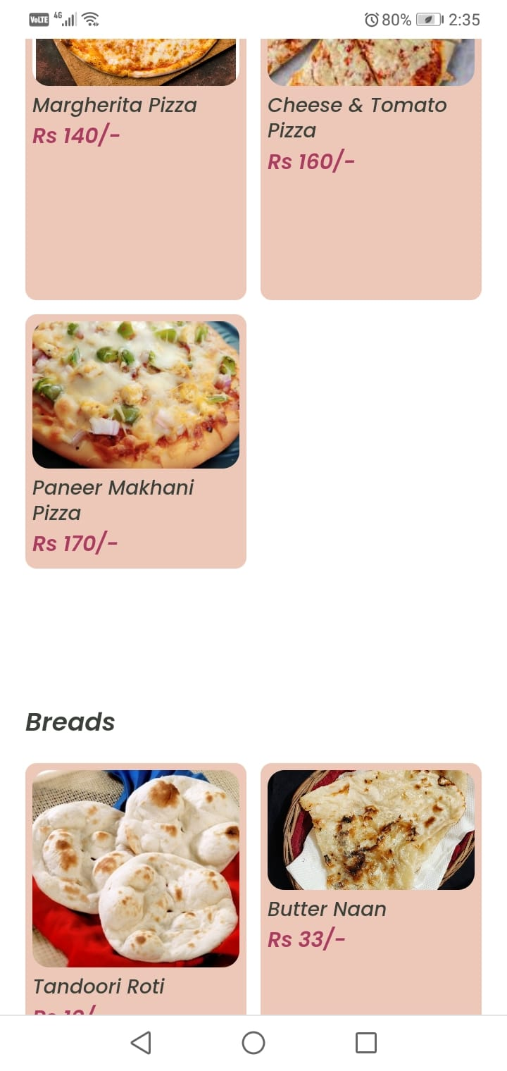
SNAPSHOTS
Snapshots from the Website
(Mobile View):

Slide 14
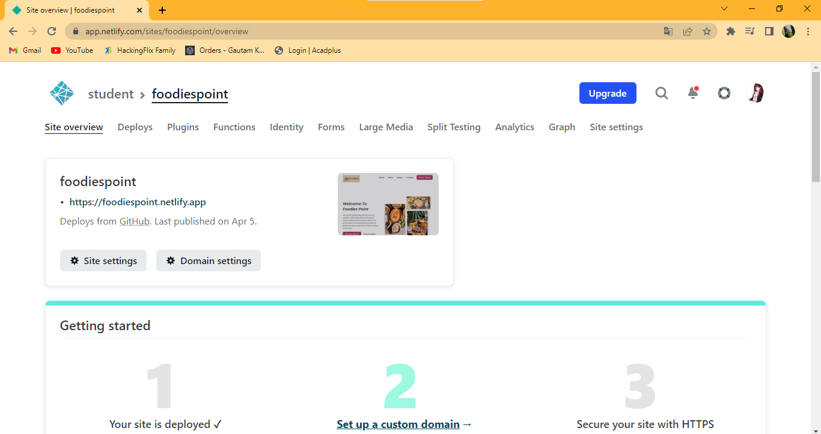
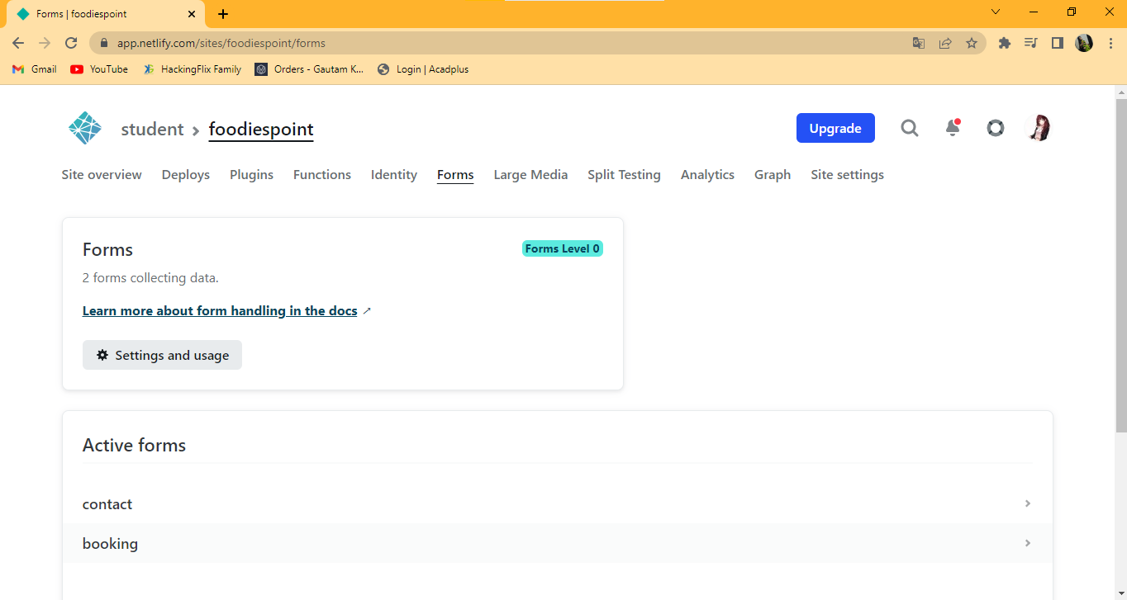
SNAPSHOTS
Snapshots from Netlify:

Slide 15

CONCLUSION
This project has really been faithful and informative. It has made us learn and understand the many trivial concepts of HTML & CSS
The fast-growing use of internet confirms the good future and scope of the proposed project.
Finally, it has taught us a valuable lifelong lesson about the improvements, working and interacting in a group.

Slide 16

FUTURE SCOPE
Site should be regularly updated
Regular Customers can be notified about coming events through their emails
Online Food Ordering might be more attractive
Developing the website in such a way that its existing features can be modified to better

Slide 17


